Slide 1

FPT University
Android programMing
Lesson 13
Version 1.0

Slide 2
Agenda
Notifications
Direct Reply Notification

Slide 3
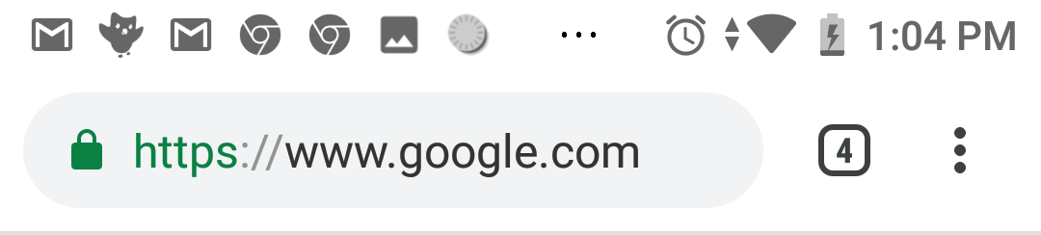
Notifications
Overview of Notifications
When a notification is initiated on an Android device, it appears as an icon in the status bar
To view the notifications, the user makes a downward swiping motion starting at the status bar to pull down the notification shade

Slide 4
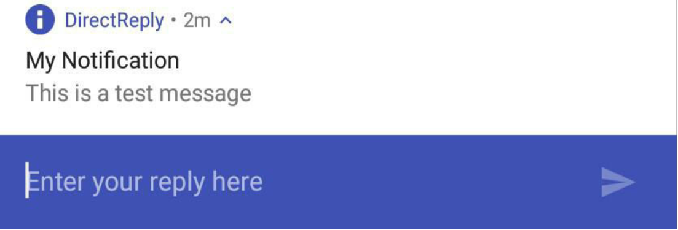
Notifications
Overview of Notifications
A typical notification will simply display a message and launch the app responsible for issuing the notification when tapped.
With Android 7, it is now also possible for the user to enter an inline text reply into the notification and send it to the app

Slide 5
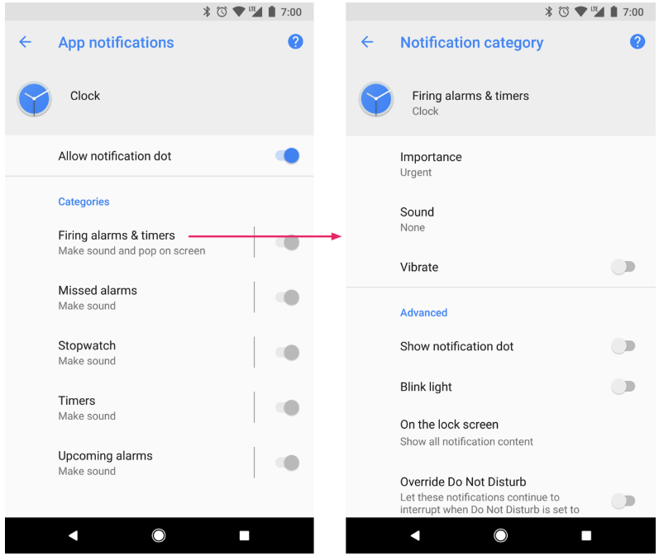
Notifications
Notification channel
Starting in Android 8.0 (API level 26), all notifications must be assigned to a channel. Each channel can set the visual and auditory behavior that is applied to all notifications in that channel. Then, users can change these settings and decide which notification channels from your app should be intrusive or visible at all.

Slide 6
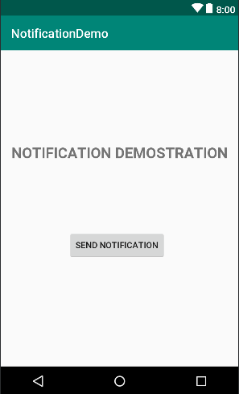
Notifications
Creating the Notification demo Project

Slide 7
Notifications
Creating and Issuing a Basic Notification
public void sendNotification(View view) { NotificationCompat.Builder builder = new NotificationCompat.Builder(this) .setSmallIcon(android.R.drawable.ic_dialog_info) .setContentTitle("A Notification") .setContentText("This is an example notification") .setChannelId(NOTIFICATION_CHANNEL); NotificationChannel channel = new NotificationChannel(NOTIFICATION_CHANNEL, "My notification channel", NotificationManager.IMPORTANCE_HIGH); NotificationManager notificationManager = (NotificationManager) getSystemService(Context.NOTIFICATION_SERVICE); notificationManager.createNotificationChannel(channel); notificationManager.notify(notificationId, builder.build()); }

Slide 8
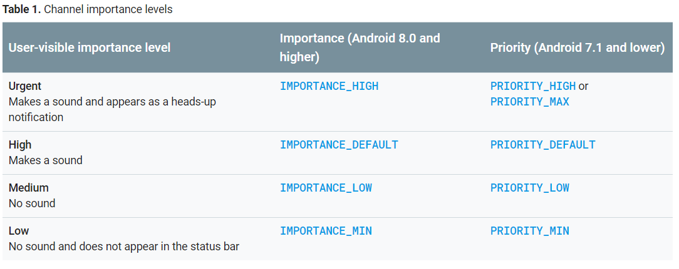
Notifications

Slide 9
Notifications
Launching an Activity from a Notification
Intent resultIntent = new Intent(this, MainActivity.class); PendingIntent pendingIntent = PendingIntent.getActivity(this, 0, resultIntent, PendingIntent.FLAG_UPDATE_CURRENT); Builder.setContentIntent(pendingIntent);

Slide 10
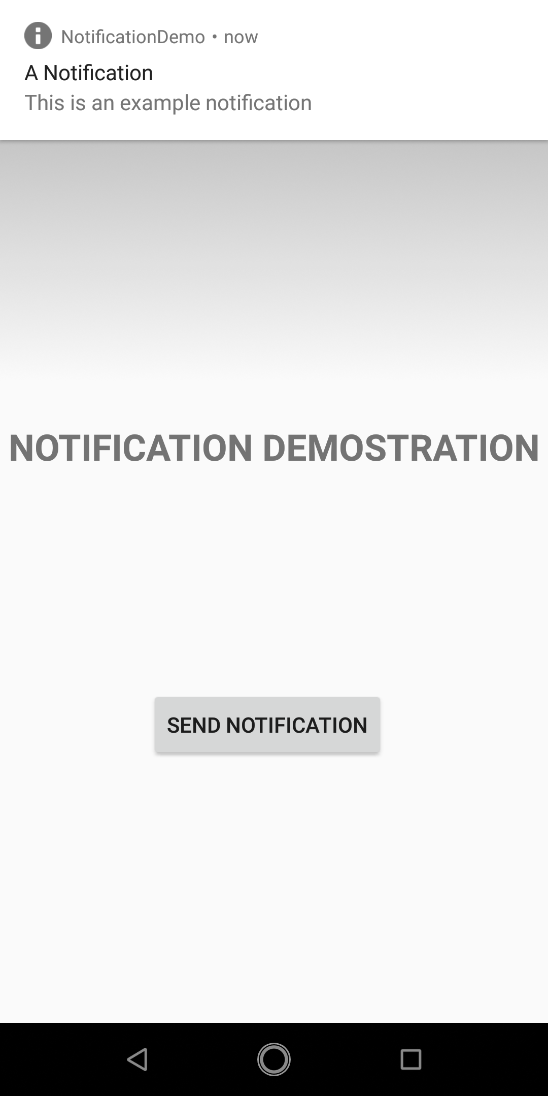
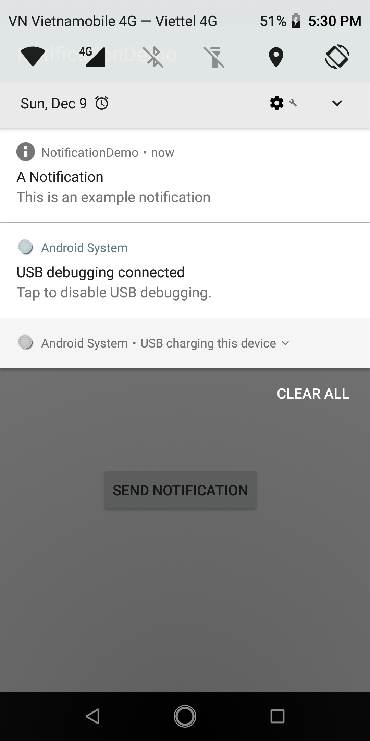
Notifications
Testing Application

Slide 11
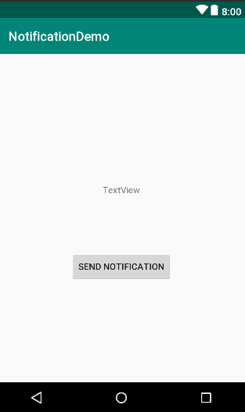
Direct Reply Notification
Creating the DirectReply Project

Slide 12
Direct Reply Notification
The RemoteInput class allows a request for user input to be included in the PendingIntent object along with the intent. When the intent within the PendingIntent object is triggered, for example launching an activity, that activity is also passed any input provided by the user.

Slide 13
Direct Reply Notification
Building the RemoteInput Object
private static int notificationId = 101; private final String NOTIFICATION_CHANNEL = "My channel"; private static String KEY_TEXT_REPLY = "key_text_reply"; public void sendNotification(View view) { String replyLabel = "Enter your reply here"; RemoteInput remoteInput = new RemoteInput.Builder(KEY_TEXT_REPLY) .setLabel(replyLabel) .build(); }

Slide 14
Direct Reply Notification
Creating the PendingIntent
Intent resultIntent = new Intent(this, MainActivity.class); PendingIntent resultPendingIntent = PendingIntent.getActivity(this, 0, resultIntent, PendingIntent.FLAG_UPDATE_CURRENT);
Notes:
requestCode is used to retrieve the same pending intent instance later on (for cancelling, etc).

Slide 15
Direct Reply Notification
Creating the Reply Action
NotificationCompat.Action replyAction = new NotificationCompat.Action.Builder( android.R.drawable.ic_dialog_info, "Reply", resultPendingIntent) .addRemoteInput(remoteInput) .build();

Slide 16
Direct Reply Notification
Raise a notification
Notification newMessageNotification = new NotificationCompat.Builder(this) .setColor(ContextCompat.getColor(this, R.color.colorPrimary)) .setSmallIcon(android.R.drawable.ic_dialog_info) .setContentTitle("My Notification") .setContentText("This is a test message") .addAction(replyAction) .setChannelId(NOTIFICATION_CHANNEL) .build(); NotificationManager notificationManager = (NotificationManager) getSystemService(Context.NOTIFICATION_SERVICE); notificationManager.notify(notificationId, newMessageNotification);

Slide 17
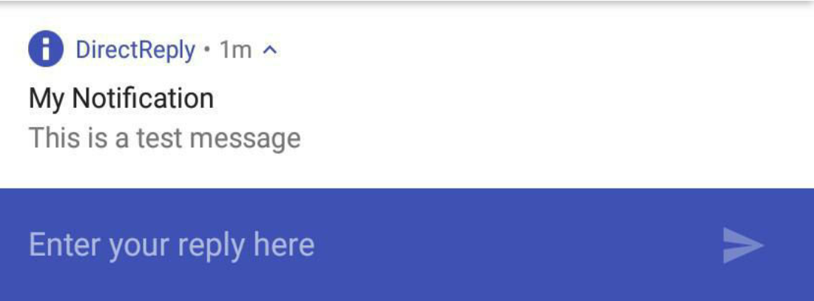
Direct Reply Notification
First testing application

Slide 18
Direct Reply Notification
Receiving Direct Reply Input
protected void onCreate(Bundle savedInstanceState) { super.onCreate(savedInstanceState); setContentView(R.layout.activity_direct_reply_notification); Intent intent = this.getIntent(); Bundle bundleData = RemoteInput.getResultsFromIntent(intent); if (bundleData != null) { TextView myTextView = (TextView)findViewById(R.id.textView2); String inputString = bundleData.getCharSequence( KEY_TEXT_REPLY).toString(); myTextView.setText(inputString); } }

Slide 19
Direct Reply Notification
Updating the Notification
if (remoteInput != null) { TextView myTextView = (TextView) findViewById(R.id.textView2); String inputString = remoteInput.getCharSequence( KEY_TEXT_REPLY).toString(); myTextView.setText(inputString); Notification repliedNotification = new Notification.Builder(this) .setSmallIcon(android.R.drawable.ic_dialog_info) .setContentText("Reply received") .setChannelId(NOTIFICATION_CHANNEL) .build(); NotificationManager notificationManager = (NotificationManager) getSystemService(Context.NOTIFICATION_SERVICE); notificationManager.notify(notificationId, repliedNotification); }

Slide 20
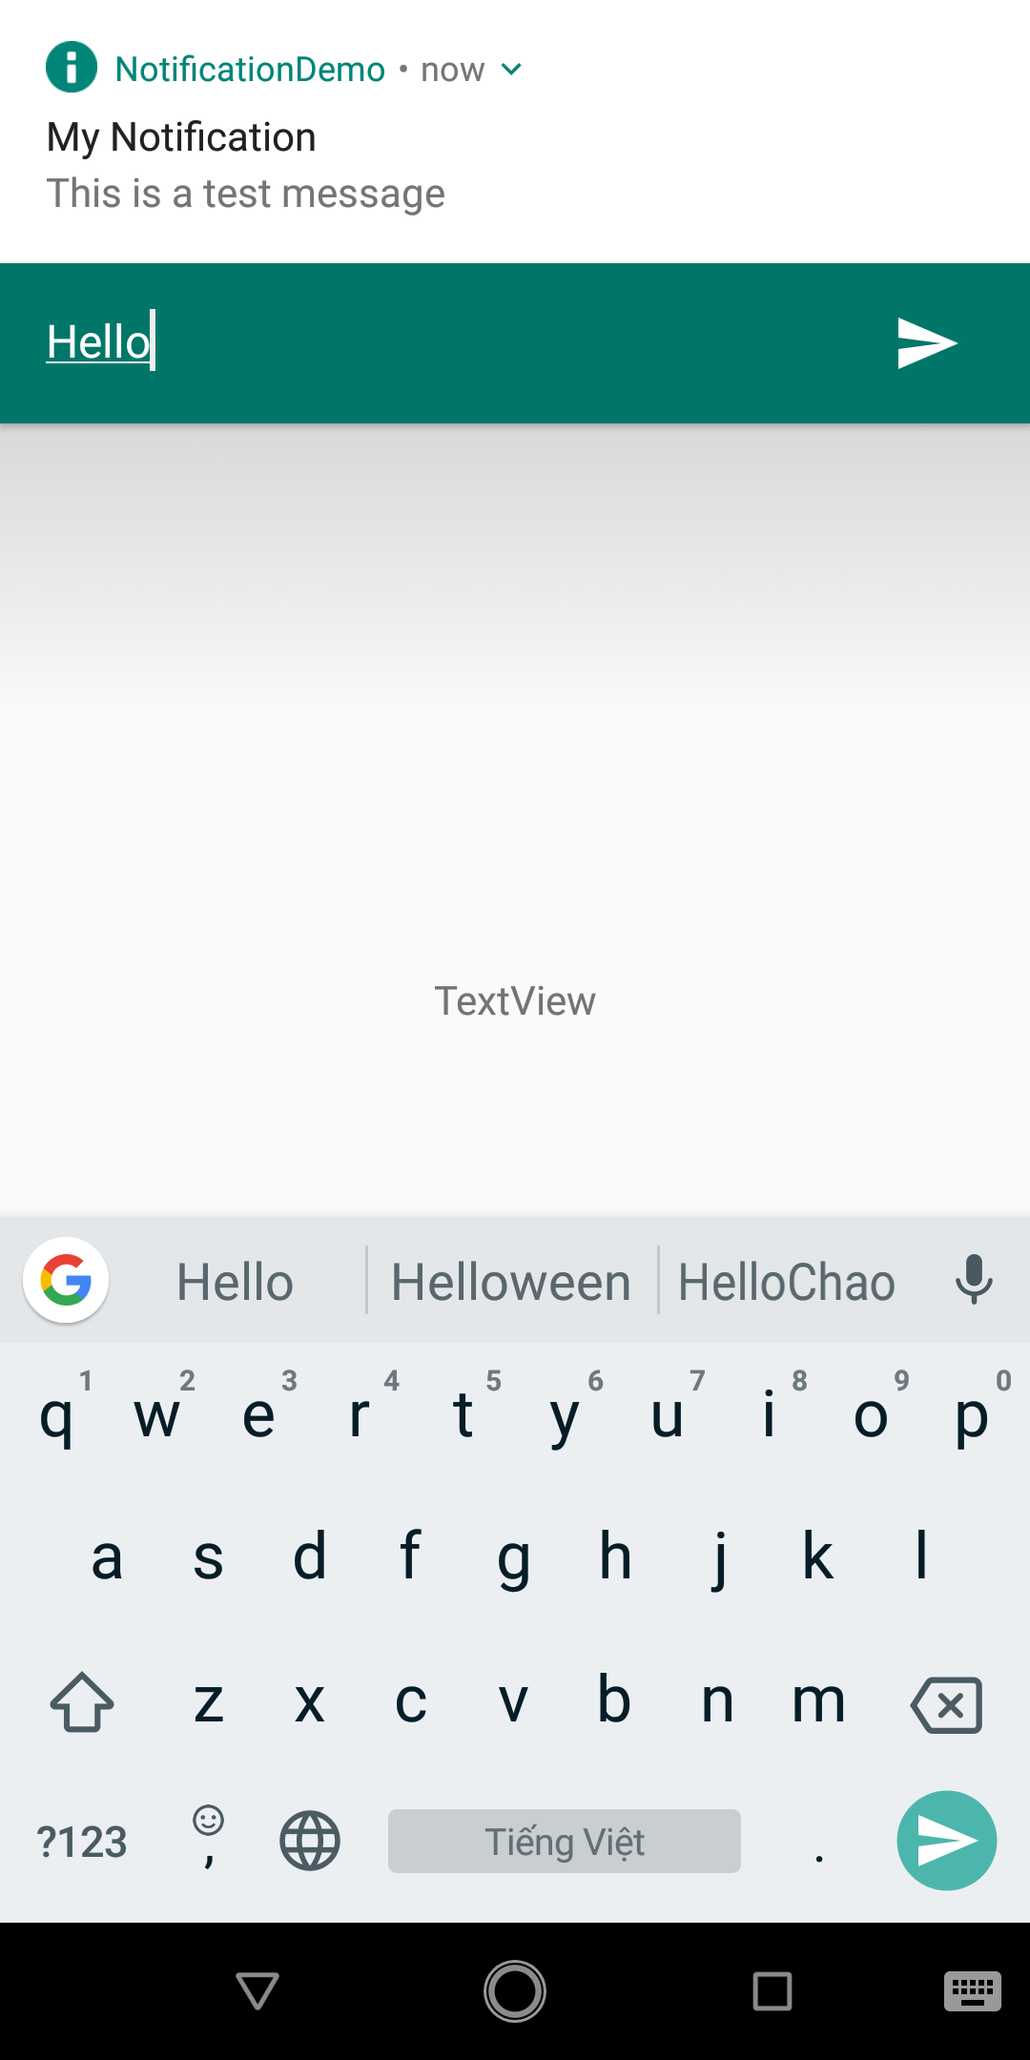
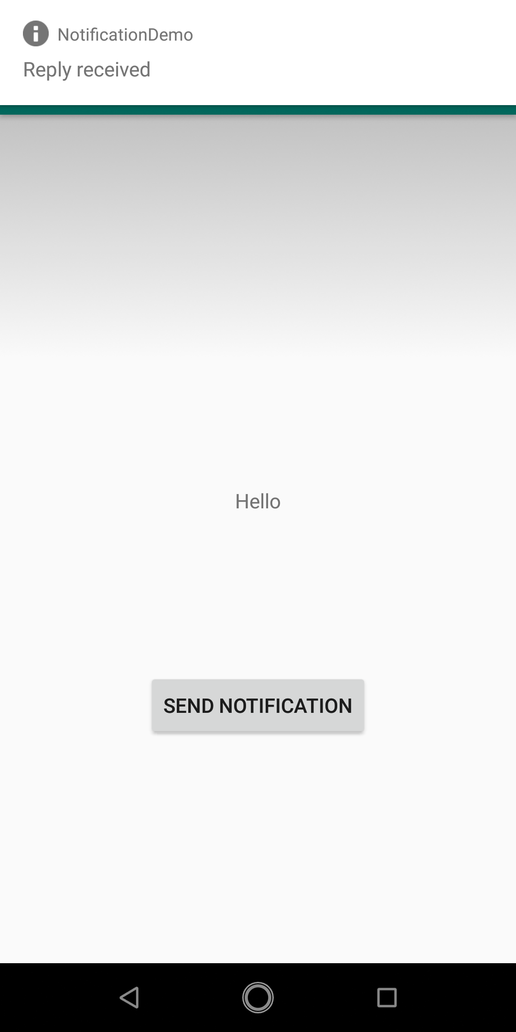
Direct Reply Notification
Testing application

Slide 21

End of Lesson 13

Slide 22
Thank you!

